Slide 1
Development of New Capabilities and Enhancements to the USACE Two-Dimensional Reservoir Water Quality Model (CE-QUAL-W2)
Principle Investigator Lead: Todd Steissberg (ERDC)
Product Development Team:
Zhonglong Zhang (PSU)
Scott Wells (PSU)
Isaac Mudge (USACE-MVN/ERDC)
John Kucharski (ERDC)
Billy Johnson (ERDC)
Barry Bunch (ERDC)
Corps District Collaboration:
Brian Zettle (TNTCX, CoP Lead)
Kathryn Tackley (Portland District)
Dan Turner (Northwest Division)
Alexis Mills (Northwest Division)
Mark Campbell (Nashville District)
Sarah Pedrick (Nashville District)
Mishael Umlor (Walla Walla District)

Slide 2
Project Purpose - Recap
SON ENV 1174, Development of New Capabilities and Enhancements to the USACE Two-Dimensional Reservoir Water Quality Model (CE-QUAL-W2)
SON ENV 1550, Two-Dimensional Water Quality Capabilities for Reservoir Operations Decision-Making.
Objectives:
Upgrade CE-QUAL-W2 to incorporate the latest water quality modeling R&D at ERDC
Restructure CE-QUAL-W2 model to use robust data storage files, e.g., HDF5 and CSV, enabling seamless linkage with other models, e.g., HEC-RAS and HEC-ResSim, improving multi-model system reliability and reducing maintenance cost of software, models, and linked modeling systems.
Decouple the WQ component from hydrodynamics in the current version of CE-QUAL-W2, allowing water quality simulations to run multiple times with the same hydrodynamic results, thus eliminating costly repeated hydrodynamic computations
Update the technical reference manual and user manual
Release comprehensive version of CE-QUAL-W2, reviewed by ERDC experts
Notes:
Keep it simple and clear. You may use a second slide if needed, however.

Slide 3
Project Objectives
Upgrade Water Quality Kinetics
Upgrade W2 Model Input and Output
Create Python/Jupyter Model Framework
Develop Reservoir Operations Capabilities
Upgrade Hydrodynamic & Water Quality Computation Engine
CE-QUAL-W2 v5.0 final version with documentation

Slide 4
Research & Development Value
Value to USACE:
The updated CE-QUAL-W2 model will support the Corps’ high priority need for environmental assessment, restoration, and management.
Incorporation of reservoir operations capabilities will enable water quality and other environmental objectives to inform reservoir release decisions, improving model accuracy and delivering high quality multi-objective decision-making to achieve ecosystem benefits.
Critical downstream habitat will be better managed for water quantity (volume, velocity, depths, etc.) in addition to water quality (water temperature, dissolved oxygen, total dissolved gas, etc.)
Linkage of WQ with multi-objective decision analysis increases project benefits while decreasing modeling and project costs.
Notes:
Keep it simple and clear. You may use a second slide if needed, however.

Slide 5
Research & Development Value
Value outside USACE:
Widely used by other federal, state, and local agencies, e.g., USGS, USBR, State of California for environmental impact assessments, planning studies, etc.
Used as a research tool by researchers at universities and other organizations. At least 1,500 publications have utilized or referenced CE-QUAL-W2 in the year 2022 alone.
“The number of publications that focused on water quality simulations using CE-QUAL-W2 ranked first most often, reaching 22 in 2020.” – Bai et al. (2022). Assessment and a review of research on surface water quality modeling. Ecological Modelling. https://doi.org/10.1016/j.ecolmodel.2022.109888
Notes:
Keep it simple and clear. You may use a second slide if needed, however.

Slide 6
Approach
Task 1: Upgrade Water Quality Kinetics
Incorporate new capabilities developed at ERDC-EL into the current CE-QUAL-W2 model maintained by Portland State University (PSU)
Develop and integrate a full carbon cycle with nitrogen and phosphorous cycles and integrate into the updated version
Reformulate simulations of BOD groups (CBOD, NBOD, and PBOD) included in current version of W2 to ensure appropriate simulation of these constituents
Upgrade the sediment diagenesis module and merge into the updated version for further testing and validation
Add new water quality state variables (CH₄, H₂S, SO₄, Fe and Mn Species) into updated version
Notes:
Keep it simple and clear. Particularly with modeling efforts - the interaction of different models, modules and updates needs to be clear. Where in the grand scheme of things does this research fit?

Slide 7
Approach
Task 2: Upgrade W2 Model Input and Output
Restructure code in order to change storage formats, thereby enabling seamless linkage with other models
Transition to a modern and robust storage files, e.g., HDF5 and CSV, that reduce errors, enable validation, and facilitate data sharing between models
Develop a utility to import previous W2 model inputs into the new data storage formats for the updated version
Task 3: Create Python/Jupyter Model Framework
Develop new Python-based framework and utilities to foster development of new input/output, visualization, and analysis capabilities
Notes:
Keep it simple and clear. Particularly with modeling efforts - the interaction of different models, modules and updates needs to be clear. Where in the grand scheme of things does this research fit?

Slide 8
Approach
Task 4: Develop Reservoir Operations Capabilities
Enable W2 to incorporate water quality and other environmental objectives into reservoir releases calculations, while balancing these with flood control, hydropower, navigation, water supply, and navigation objectives
Incorporate capability into W2 to examine dam flow control impacts on downstream water quality and determine how downstream temperature and water quality objectives will be met
Create capabilities in W2 to examine impacts of dams and flow regulation on downstream temperature and water quality conditions while identifying how operations may be improved to maximize ecosystem benefits
Notes:
Keep it simple and clear. Particularly with modeling efforts - the interaction of different models, modules and updates needs to be clear. Where in the grand scheme of things does this research fit?

Slide 9
Approach
Task 5: Upgrade Hydrodynamic & Water Quality Computation Engine
Decouple water quality component from hydrodynamics in W2 in cases where the water quality state variable does not impact hydrodynamics, thereby increasing computational efficiency
Run hydrodynamic simulations for a prescribed period, store output, and use data as input for multiple water quality simulations
Implement a simultaneous equation solution of the water surface in all branches for the updated model, enhancing hydrodynamic stability of riverine segments
Support increasing demand to include water quality operating objectives for water management by updating selective withdrawal algorithm to account for overlapping withdrawal zones for multiple outlets (versus simply adding them together)
Evaluate using multi-core processing capability with numerical precision of simulations vs. fast code execution
Notes:
Keep it simple and clear. Particularly with modeling efforts - the interaction of different models, modules and updates needs to be clear. Where in the grand scheme of things does this research fit?

Slide 10
Approach
Task 6: CE-QUAL-W2 v5.0 final version with documentation
Prepare and post final release version of CE-QUAL-W2 Version 5.0 to the ERDC website for release
Conduct a case study demonstrating all capabilities included in the final release version of CE-QUAL-W2 and document in a technical note
Post updated CE-QUAL-W2 Technical Reference Manual and User’s Manual to ERDC’s web site
Prepare a final webinar using the case study and present to USACE District and Division staff, including water quality modelers and managers
Notes:
Keep it simple and clear. Particularly with modeling efforts - the interaction of different models, modules and updates needs to be clear. Where in the grand scheme of things does this research fit?

Slide 11
Collaboration & Communication Plan
Project Planning
Quarterly team web meetings with RARG PDT and District Proponents
Weekly development meetings – status updates, feedback, course corrections
Quarterly progress updates via email to PDT
Reporting -
Journal paper, Reservoir System Water Quality Modeling with CE-QUAL-W2 Version 5.0.
RARG PDT members and district collaborators will provide input on document planning and review of drafts
Annual CE-QUAL-W2 workshop. FY23 workshop: May 2023 at Walla Walla District
Field Work Coordination
Coordinate with Fort Worth District on Trinity River water quality sampling

Slide 12
Scheduled Products
Scheduled Products
Description | Scheduled Due Date | Current Percent Complete | Projected Completion Date
 | (Qtr/Yr) | (%) | (Qtr/Yr)
1. CE-QUAL-W2 Version 4.5 | Q2/FY21 | 100 | Q2/FY21
2. CE-QUAL-W2 Version 5.0 Alpha | Q2/FY22 | 100 | Q1/FY22
3a. Python Framework 3b. Prototype Jupyter Notebook 3c. Plotting Capability | Q1/FY21 Q1/FY21 Q1/FY21 | 100 100 100 | Q1/FY21 Q1/FY21 Q1/FY21
4. CE-QUAL-W2 Operations Capability | Q2/FY22 | 60 | Q1/FY23
Notes:
Include all PRODUCTS/DELIVERABLES as specified in the original WU documentation

Slide 13
Scheduled Products
Scheduled Products
Description | Scheduled Due Date | Current Percent Complete | Projected Completion Date
 | (Qtr/Yr) | (%) | (Qtr/Yr)
5. CE-QUAL-W2 Version 5.0 Beta | Q2/FY23 | 25 | Q3/FY23
6a. CE-QUAL-W2 Version 5.0 Final 6b. User Manual 6c. Technical Reference Manual 6d. Webinar Workshop (3 days) 6e. Technical Note | Q4/FY23 Q4/FY23 Q4/FY23 Q4/FY23 Q4/FY23 | 0 75 75 90 0 | Q4/FY23 Q4/FY23 Q4/FY23 Q4/FY22 Q4/FY23
Notes:
Include all PRODUCTS/DELIVERABLES as specified in the original WU documentation

Slide 14
Additional Products/Achievements¹
Additional Products/Achievements
Description | (Qtr/Yr)
Recruited computer scientist at EL-EPW in FY21 Recruiting DB-IV research scientist to replace team member that departed ERDC New CE-QUAL-W2 capabilities presented at National Conference for Ecosystem Restoration (NCER), July 2021 Additional features developed for V4.5, funded by reimbursable projects New features presented at California Water and Environmental Modeling Forum (CWEMF), October 2021 Prepared and presented 3-day CE-QUAL-W2 water quality modeling workshop at ERDC, with 45 students in attendance. This was ERDC’s first workshop since CE-QUAL-W2’s release in 1986. | Q3/FY21 Q3/FY21 Q4/FY21 Q4/FY21 Q1/FY22 Q4/FY22

Slide 15
FY22 Accomplishment 1: Extended CE-QUAL-W2 WQ Algorithms (Task 1)
Added new water quality state variables:
Dissolved Gas Pressure (DGP), H₂S, CH₄, SO₄, Fe, FeOOH, Mn, MnO₂, NH₃, Turbidity, and Secchi Depth
Status: Completed
Notes:
Describe product and capability, importance/impact, etc.. Employ images generously. Tell a good story.

Slide 16
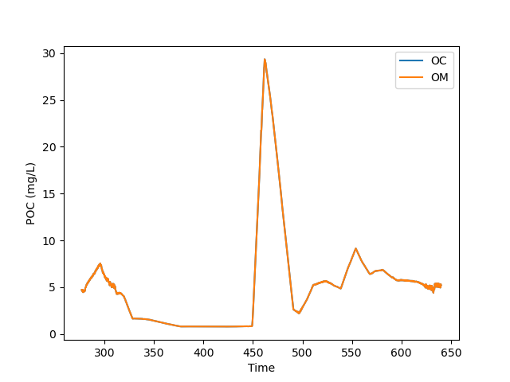
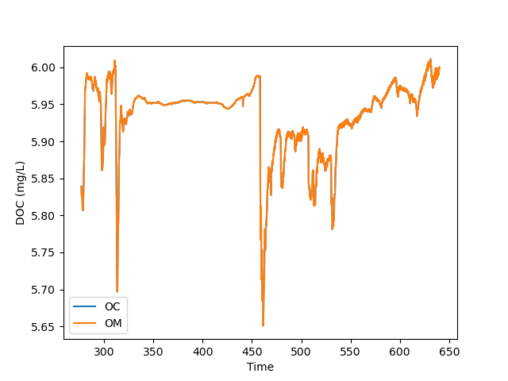
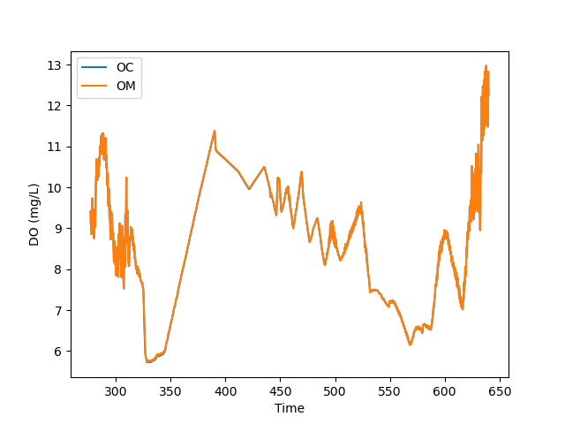
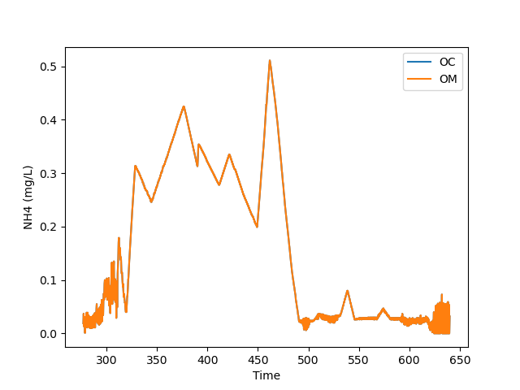
FY22 Accomplishment 1: Extended CE-QUAL-W2 WQ Algorithms (Task 1)
Tested full Organic Carbon Cycle and BOD
Modeled POC, DOC, NH4, and DO for the Minnesota River, using new Organic Carbon Cycling
Status: Completed
Notes:
Describe product and capability, importance/impact, etc.. Employ images generously. Tell a good story.

Slide 17
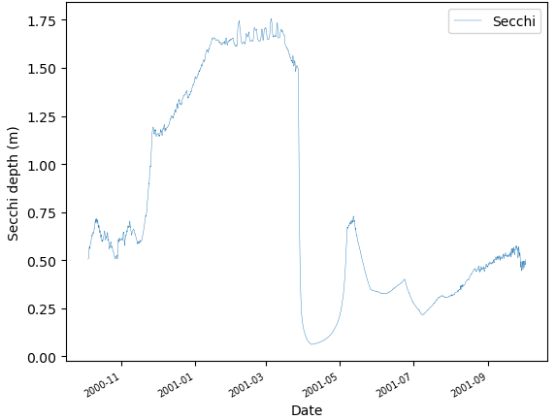
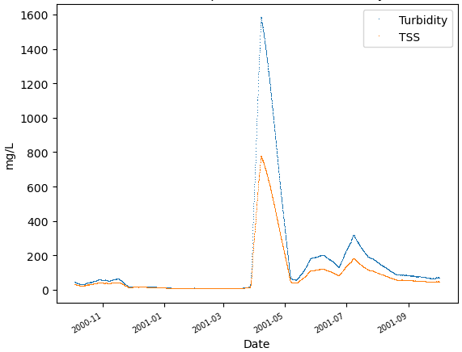

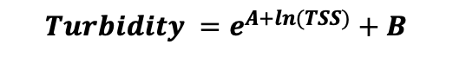
FY22 Accomplishment 1: Extended CE-QUAL-W2 WQ Algorithms (Task 1)
Tested new Secchi Depth and Turbidity variables
Modeled Secchi Depth and Turbidity for the Minnesota River
$Secchi =$ $\frac{A}{λ}$
$$Turbidity =e^{A+ln(TSS)}+B$$
Status: Completed
Notes:
Describe product and capability, importance/impact, etc.. Employ images generously. Tell a good story.

Slide 18
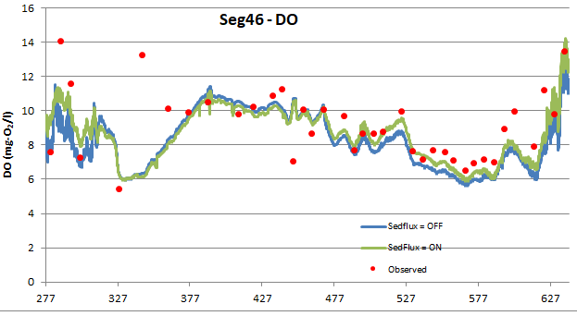
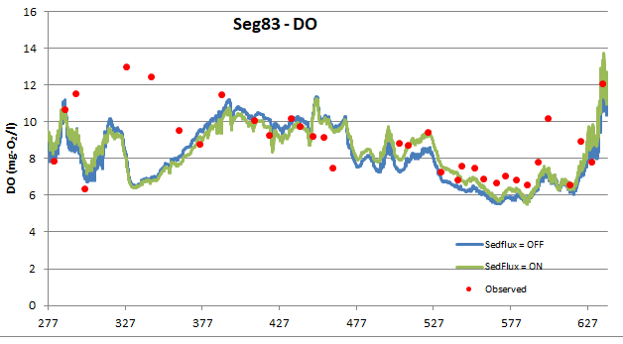
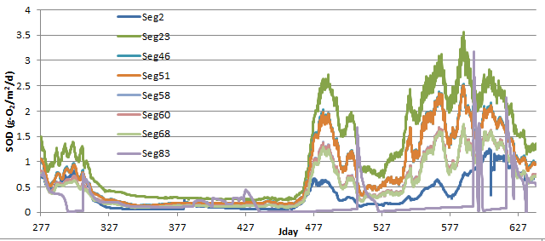
FY22 Accomplishment 1: Extended CE-QUAL-W2 WQ Algorithms (Task 1)
Tested Sediment Diagenesis Module (SedFlux = ON/OFF)
Modeled Dissolved Oxygen (DO) and Sediment Oxygen Demand (SOD) for the Minnesota River
Status: Completed
Notes:
Describe product and capability, importance/impact, etc.. Employ images generously. Tell a good story.

Slide 19
FY22 Accomplishment 1: Extended CE-QUAL-W2 WQ Algorithms (Task 1)
Tested Dissolved Gas Pressure (DGP)
Modeled TDG at Bonneville Dam when DGP simulation is enabled
Status: Completed
Notes:
Describe product and capability, importance/impact, etc.. Employ images generously. Tell a good story.

Slide 20
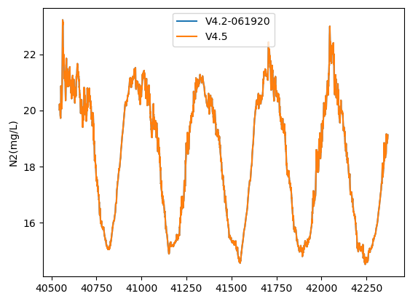
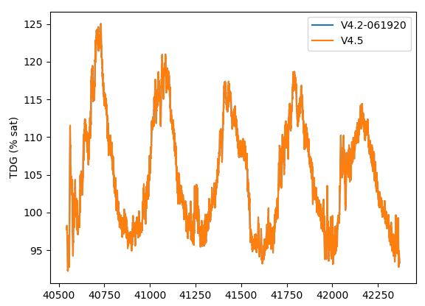
FY22 Accomplishment 1: Extended CE-QUAL-W2 WQ Algorithms (Task 1)
Tested Dissolved Nitrogen Gas (Atmospheric N₂) and Total Dissolved Gas (TDG)
Compared V4.5 and previous version results for the Bonneville Dam with TDG and N2
Status: Completed
Notes:
Describe product and capability, importance/impact, etc.. Employ images generously. Tell a good story.

Slide 21
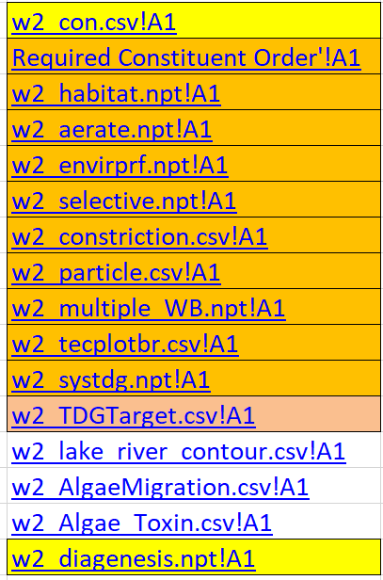
FY22 Accomplishment 2: Upgraded Model Input and Output (Task 2)
Excel file w2_con.xlsm → w2_con.csv
Capability to use Excel to create the model control files
Simplified editing of input files
No graph.npt file required
Easier cutting and pasting
Simplified I/O
Files more organized
Variable names and explanations at user’s fingertips
Formulae included in released Excel tool assist in control file development
New Development and Testing
Atmospheric deposition inputs
Selective withdrawal inputs
Model testing and validation
Bug fixes
Status: Completed
Notes:
Describe product and capability, importance/impact, etc.. Employ images generously. Tell a good story.

Slide 22
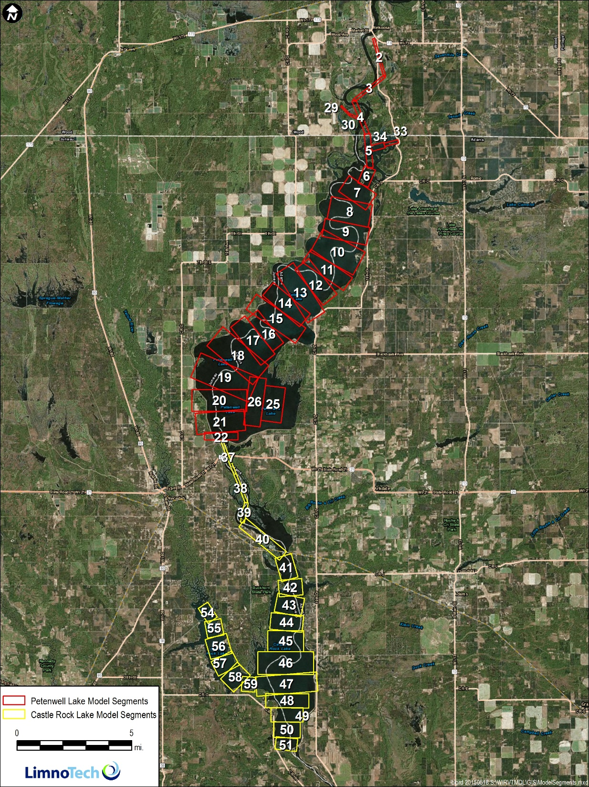
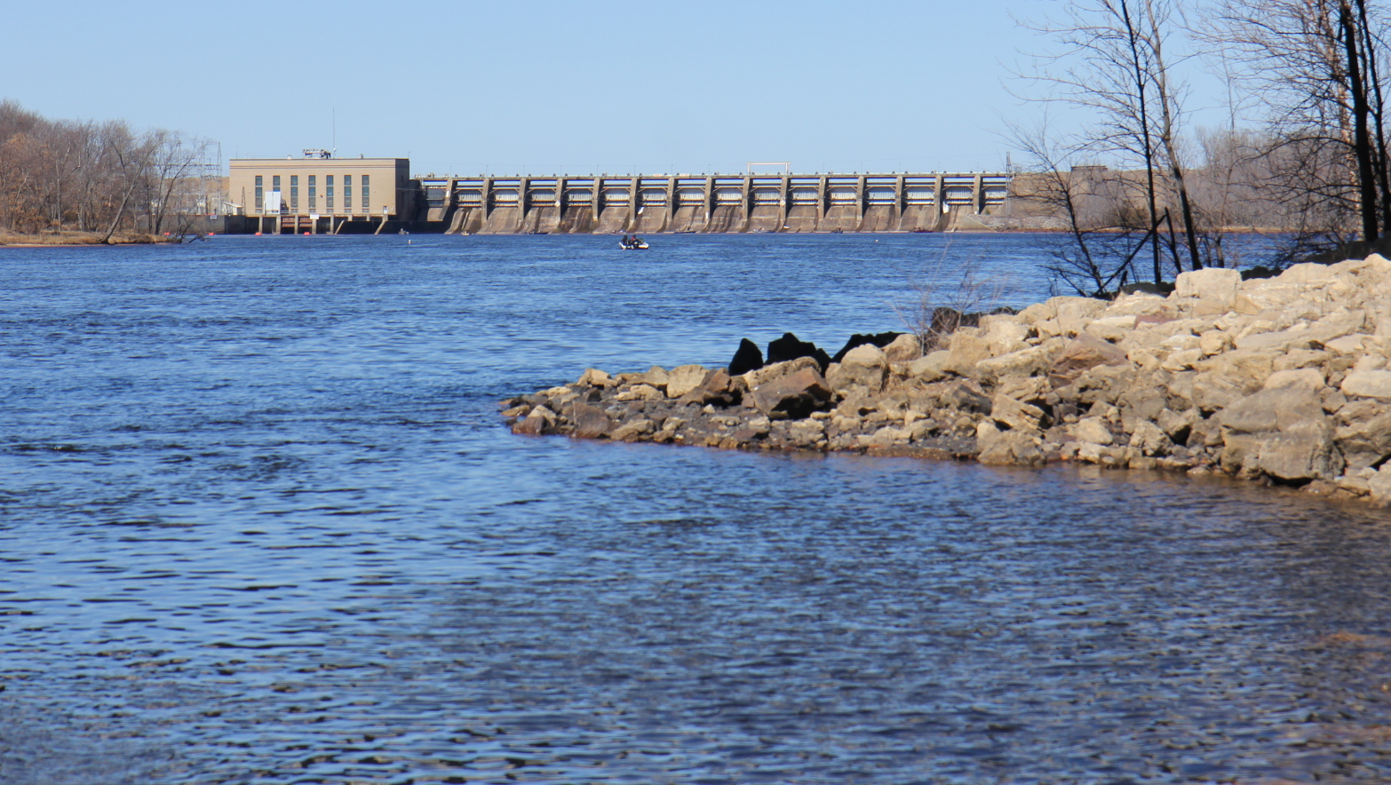
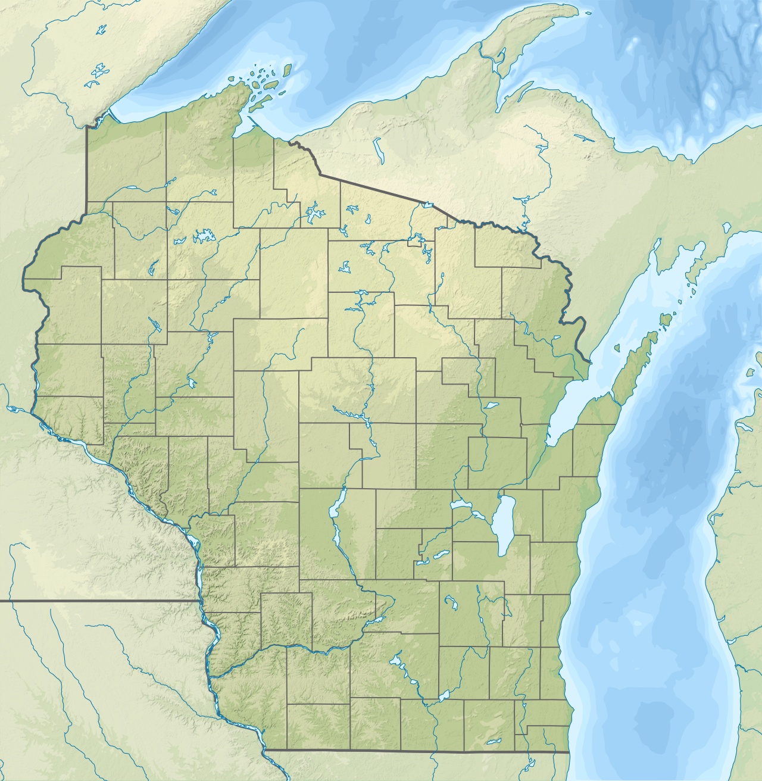
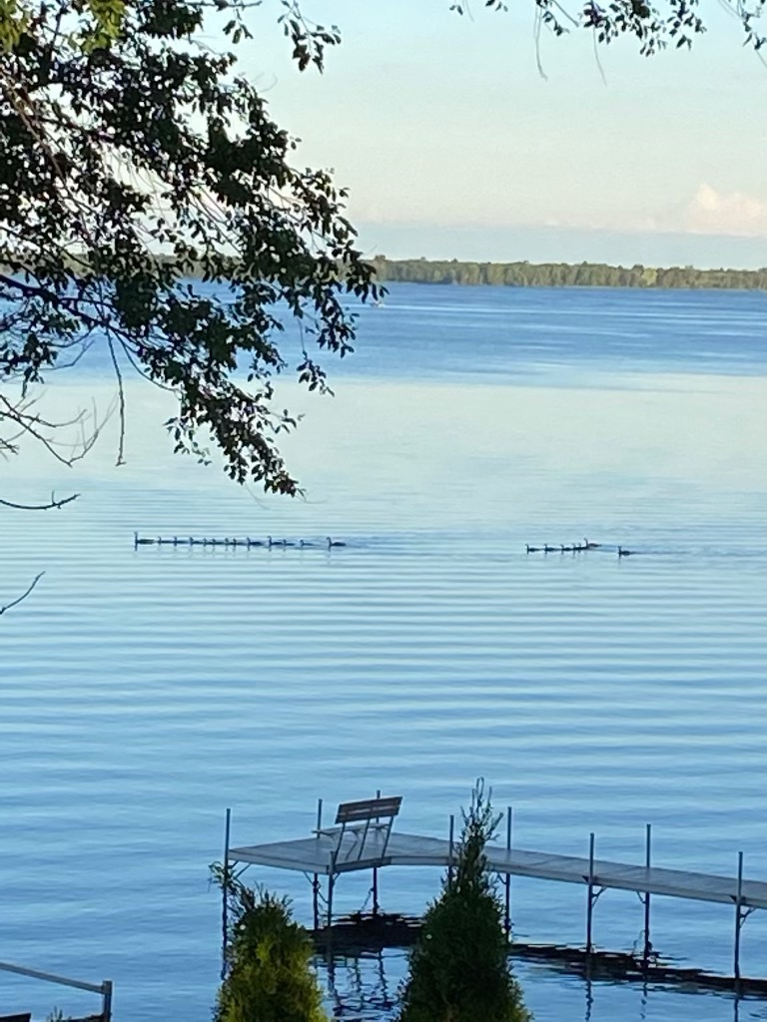
FY22 Accomplishment 5: Hydrodynamic Engine Updates (Task 5)
Improved computation efficiency for multiple water bodies
Conducted literature and code review for decoupling hydrodynamics and water quality where direct coupling is not required
CE-QUAL-W2 Modeling of Petenwell and Castle Rock Lakes, Wisconsin River
Status: On Time
Notes:
Describe product and capability, importance/impact, etc.. Employ images generously. Tell a good story.

Slide 23
FY22 Accomplishment 5: Water Quality Modeling Workshop (Task 6)
Prepared and taught a 3-day workshop
45 students registered; roughly 40% attended in person.
16 USACE Offices participated
Status: On Time (Ahead of Schedule)
Notes:
Describe product and capability, importance/impact, etc.. Employ images generously. Tell a good story.

Slide 24
Synopsis
Funding
FY20 $250K
FY21 $385K
FY22 $375K
FY23 $290K
Project $1300K
Project status
On schedule
Project focus
On target
Other comments
Delayed V5.0 development tasks to focus on workshop development and instruction for V4.5.
This workshop will be updated for V5.0 in Q4/FY23.
Notes:
Funding for all FY’s funded

Slide 25
Summary
Updated and extended water quality algorithms
Added new water quality variables: DGP, H₂S, CH₄, SO4, Fe, FeOOH, Mn, MnO₂, NH₃, Turbidity, Secchi
Upgraded model input and output
Atmospheric deposition inputs
Selective withdrawal inputs
Model testing and validation
Bug fixes
Hydrodynamics engine updates
Improved computation efficiency for multiple water bodies
Conducted literature and code review for decoupling hydrodynamics and water quality where direct coupling is not required
Prepared and taught 3-day CE-QUAL-W2 Water Quality Modeling Workshop
Conducted detailed model testing and validation and bug fixes

Slide 26
Summary
Major Findings
The Excel user interface improved the model setup process, but USACE security requirements and procedures (e.g., disabling macros) makes this unreliable.
The Python plotting capabilities enabled automatic plotting of all input and output data and automatic report generation for each model.
Lessons Learned
A Standard Operating Procedure (SOP) needed to be developed for setting up the environment to use Python programs to plot and analyze CE-QUAL-W2 data.
Future Research Needs
Port Excel macros to a Python program
Extend the current SOP and training document for using Python with CE-QUAL-W2
Vertical migration algorithms need to be extended to accurately simulate cyanobacteria
New algorithms are needed to simulate Harmful Algal Blooms
New algorithms are needed to simulate reservoir sedimentation

